Slide 1
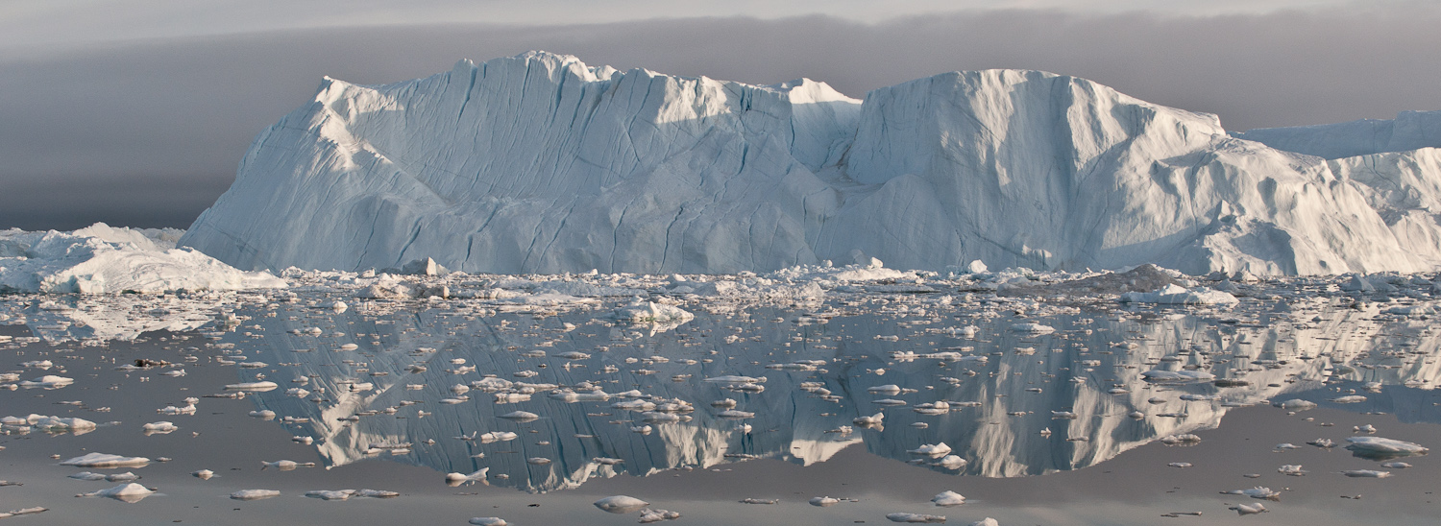
NISAR Cryosphere ATBD
Cryosphere Lead: Ian Joughin
Science Team: Rick Forster, Alex Gardner, Sean Helfrich, Ben Holt, Eric Rignot, and Bernd Scheuchl

Slide 2
Overview
Glacier and Ice Sheets:
Requirements
Algorithms
Implementations
Validation/Notebooks
Sea Ice
Requirements
Algorithms
Implementations
Validation/Notebooks

Slide 3
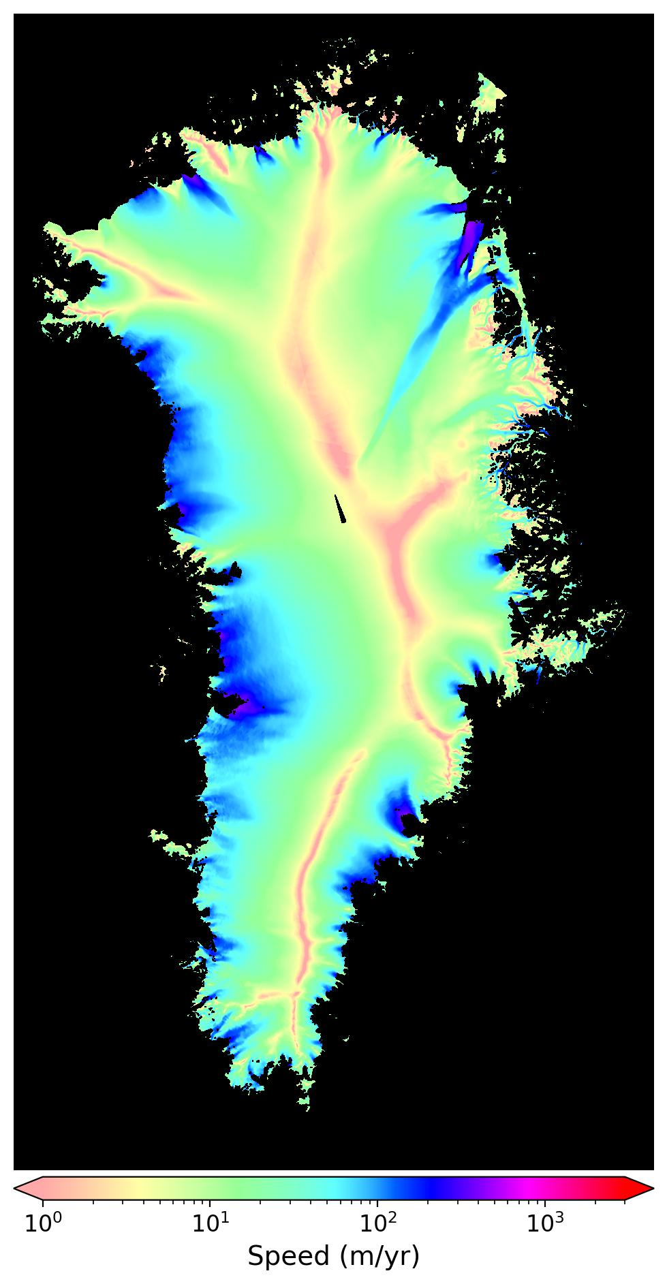
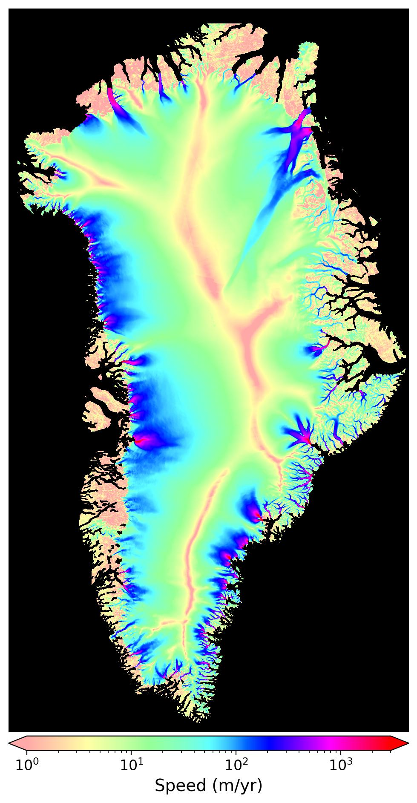
Annual Glacier & Ice Sheet Requirements
L2 Requirement 667: Annual ice sheet (> 90% coverage) horizontal velocity with accuracy better than 3% plus 1 m/yr (1-sigma), at 100-m resolution in slow areas (< 50 m/yr).
L2 Requirement 668: Annual ice sheet horizontal velocity (>90% coverage) to an accuracy better than 3% plus 5 m/yr (1-sigma), at 250-m resolution in fast areas (>50 m/yr).
Data from MEaSUREs GrIMP

Slide 4
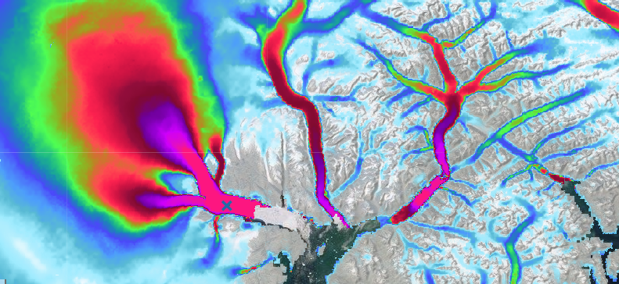
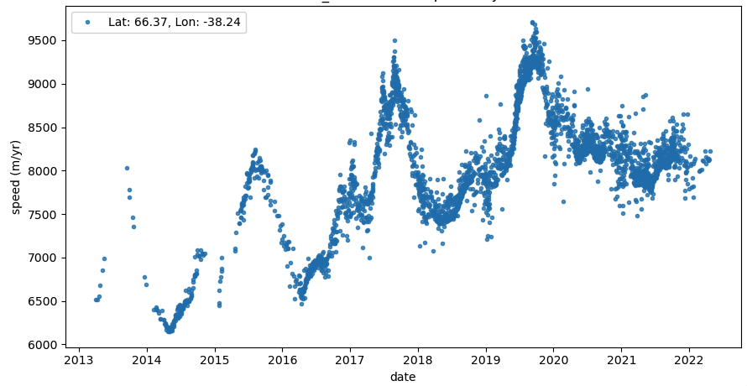
Glacier & Ice Sheet Time Series Requirement
L2 Requirement 738: Time-varying horizontal velocities at near-weekly sampling intervals in areas of potential rapid or seasonal change to an accuracy better than 3% plus 10 m/yr (1-sigma) at 500-m resolution (> 80% coverage).
Data from MEaSUREs ITS_LIVE

Slide 5
Grounding Line Requirement
L2 Requirement 445: The NISAR project shall measure the vertical differential displacement of all floating ice shelves and ice tongues with vertical accuracy of 100 mm at 100-m resolution annually (> 95% coverage) and monthly (>50% coverage).
Data from MEaSUREs Antarctica (Rignot et al., 2014)

Slide 6
ATBD Scope
The project is required to produce L0-L2 products.
The project/ST is not required to produce L3-L4 products for purposes other than cal/val. (Higher level products for some disciplines produced through additional funding, e.g., soil moisture.)
The science team’s role is to generate a sufficient number of products using the algorithms described in the ATBD to demonstrate that the requirements CAN be met.
Cal/val efforts are open science activities so all L3/L4 cal/val products and data will be freely distributed. Possible exception for non-project funded field data contributed by external groups.

Slide 7
Relevant L0-L2 Products
Speckle-tracked offsets from cross correlation of SLC pairs with error estimates:
Pros:
Data from two directions (line of sight & azimuth).
Works well for fast-moving ice.
Cons:
Coarser resolution (few hundred meters).
Poorer precision (~1/20 of a several meter pixel).
Larger ionospheric errors in azimuth direction, especially at L-band.
Unwrapped interferometric phase with error estimates:
Pros:
High precision (fraction of 24-cm wavelength).
Fine-resolutions (10s of meters).
Ionospheric correction.
Cons:
Difficult/impossible to unwrap for fast moving areas.
Only line of sight information so at least a second look direction is needed.

Slide 8
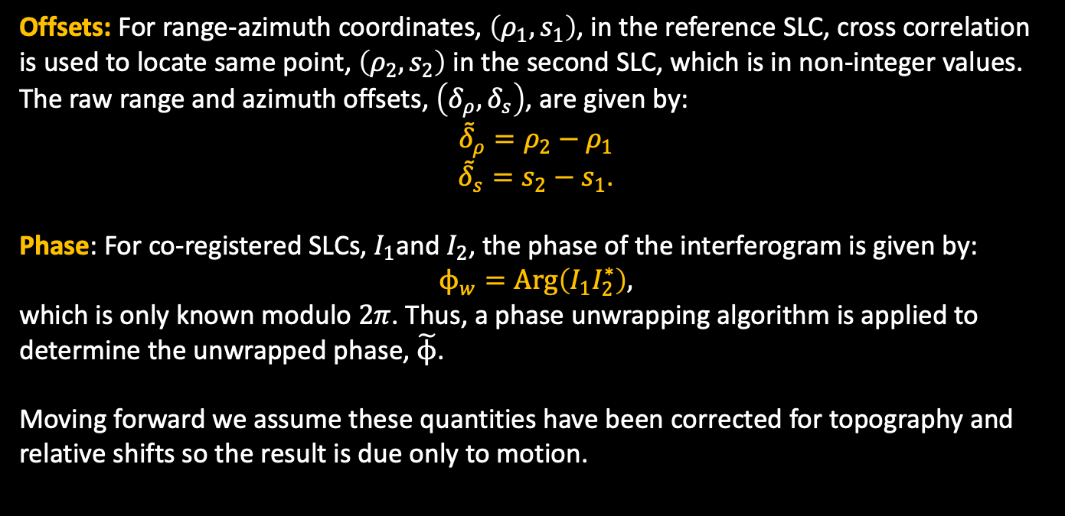
Raw Measurements
Offsets: For range-azimuth coordinates, $\left(ρ_{1},s_{1}\right)$, in the reference SLC, cross correlation is used to locate same point, $\left(ρ_{2},s_{2}\right)$ in the second SLC, which is in non-integer values. The raw range and azimuth offsets, $\left(δ_{ρ},δ_{s}\right)$, are given by:
${\tilde{δ}}_{ρ}=ρ_{2}−ρ_{1}$
${\tilde{δ}}_{s}=s_{2}−s_{1}$.
Phase: For co-registered SLCs, $I_{1}$and $I_{2}$, the phase of the interferogram is given by:
$$ϕ_{w}=Arg\left(I_{1}I_{2}^{∗}\right),$$
which is only known modulo $2π$. Thus, a phase unwrapping algorithm is applied to determine the unwrapped phase, $\tilde{ϕ}$.
Moving forward we assume these quantities have been corrected for topography and relative shifts so the result is due only to motion.

Slide 9
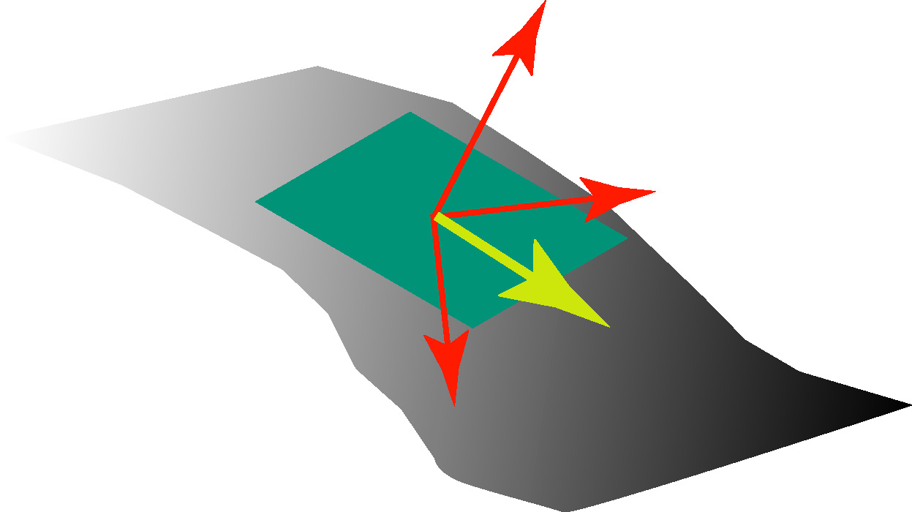
Vector Ice Velocity Measurements
Ideally vector measurements require data from three track-directions.
With a surface-parallel flow assumption, the velocity vector is determined using only two directions by assuming it lies in plane tangent to the surface.
Ignores submergence/emergence velocity (upward or downward motion to accommodate snowfall/melt).

Slide 10
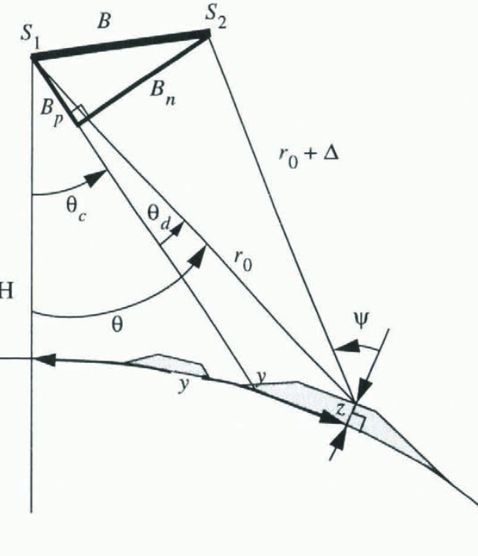
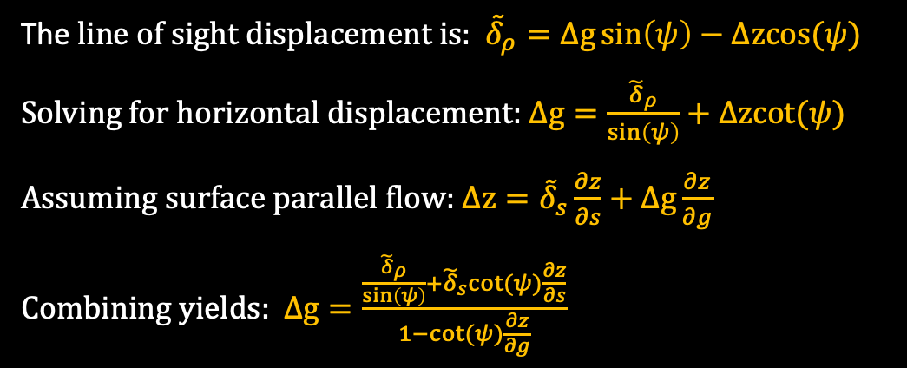
Velocity with Offsets and the Surface Parallel Assumption
The line of sight displacement is: ${\tilde{δ}}_{ρ}=∆g\sin\left(ψ\right)−∆zcos⁡(ψ)$
Solving for horizontal displacement: $∆g=\frac{{\tilde{δ}}_{ρ}}{\sin\left(ψ\right)}+∆zcot⁡(ψ)$
Assuming surface parallel flow: $∆z={\tilde{δ}}_{s}\frac{∂z}{∂s}+∆g\frac{∂z}{∂g}$
Combining yields: $∆g=\frac{\frac{{\tilde{δ}}_{ρ}}{\sin\left(ψ\right)}+{\tilde{δ}}_{s}cot⁡(ψ)\frac{∂z}{∂s}}{1−cot⁡(ψ)\frac{∂z}{∂g}}$
Velocity in radar-directed coordinates is $v_{g}=\frac{∆g}{∆T}$ and $v_{s}=\frac{{\tilde{δ}}_{s}}{∆T}$.

Slide 11
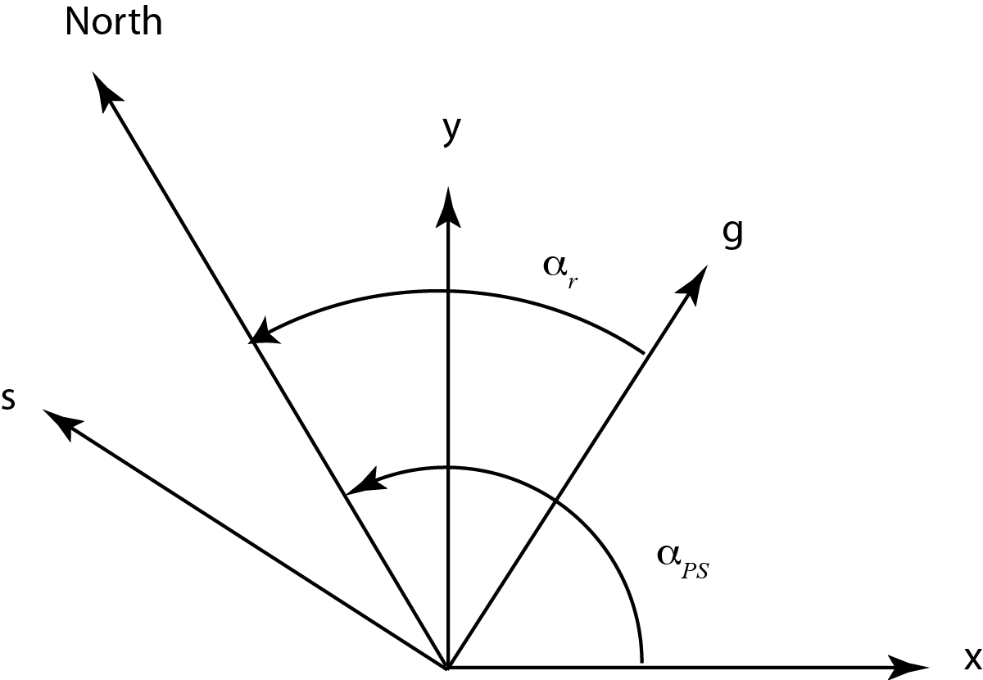
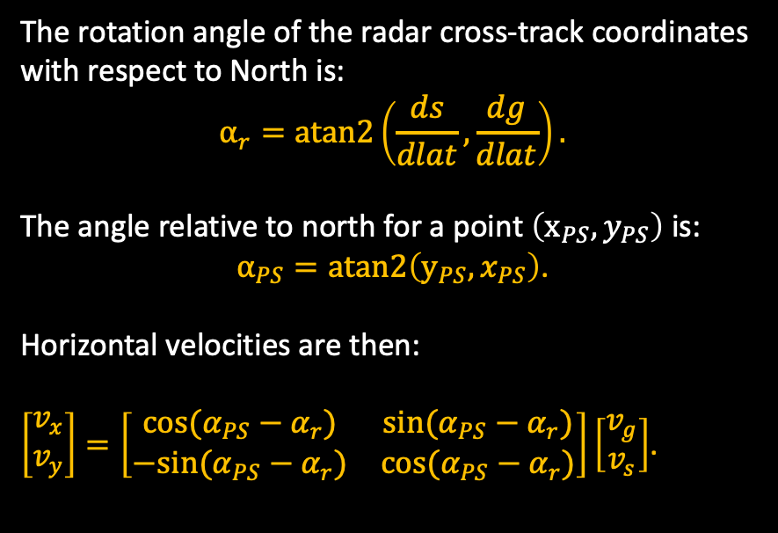
Radar to Polar Stereographic Coordinates
The rotation angle of the radar cross-track coordinates with respect to North is:
$$α_{r}=atan2\left(\frac{ds}{dlat},\frac{dg}{dlat}\right).$$
The angle relative to north for a point $\left(x_{PS}, y_{PS}\right)$ is:
$α_{PS}=atan2\left(y_{PS}, x_{PS}\right)$.
Horizontal velocities are then:
$\left[\begin{matrix}v_{x} \\ v_{y}\end{matrix}\right]=\left[\begin{matrix}cos(α_{PS}−α_{r}) & sin(α_{PS}−α_{r}) \\ −sin(α_{PS}−α_{r}) & cos(α_{PS}−α_{r})\end{matrix}\right]\left[\begin{matrix}v_{g} \\ v_{s}\end{matrix}\right]$.

Slide 12
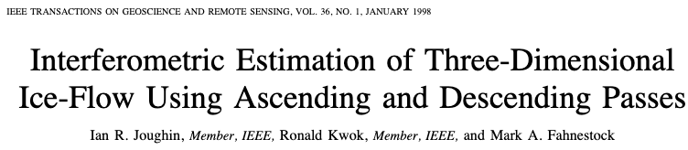
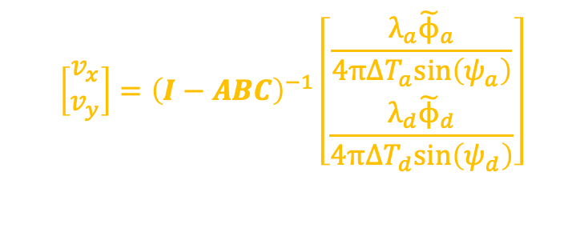
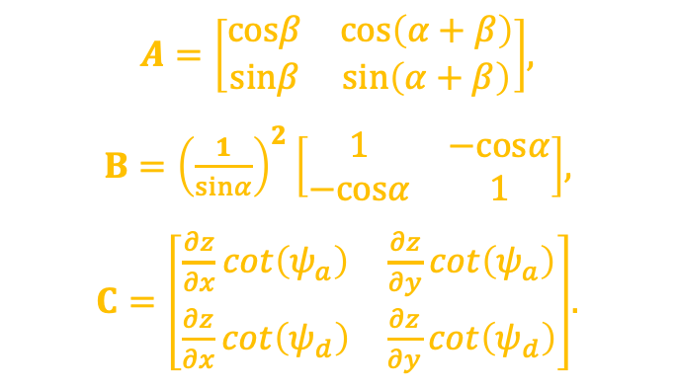
Crossing Orbit Solution
For crossing orbits and unwrapped phases, velocity is given by:
$A=\left[\begin{matrix}cosβ & cos\left(α+β\right) \\ sinβ & sin\left(α+β\right)\end{matrix}\right]$,
$B={\left(\frac{1}{sinα}\right)}^{2}\left[\begin{matrix}1 & −cosα \\ −cosα & 1\end{matrix}\right]$,
$C=\left[\begin{matrix}\frac{∂z}{∂x}cot\left(ψ_{a}\right) & \frac{∂z}{∂y}cot\left(ψ_{a}\right) \\ \frac{∂z}{∂x}cot\left(ψ_{d}\right) & \frac{∂z}{∂y}cot\left(ψ_{d}\right)\end{matrix}\right]$.
$$\left[\begin{matrix}v_{x} \\ v_{y}\end{matrix}\right]={\left(I−ABC\right)}^{−1}\left[\begin{matrix}\frac{λ_{a}{\tilde{ϕ}}_{a}}{4π∆T_{a}sin\left(ψ_{a}\right)} \\ \frac{λ_{d}{\tilde{ϕ}}_{d}}{4π∆T_{d}sin\left(ψ_{d}\right)}\end{matrix}\right]$$

Slide 13
Possible Combinations
Range-azimuth offsets from a single orbit track,
Unwrapped phase (for range) with azimuth offsets from a single orbit track,
Range-range offsets from crossing orbit tracks, and
Unwrapped phase-phase data from crossing orbits.
In practice the final result is often the inverse error weighted combination of the available data to provide the optimal result.

Slide 14

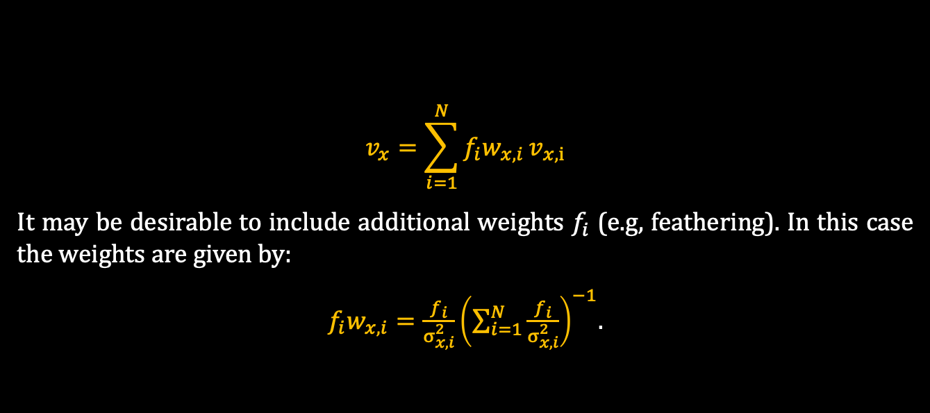
Final Weighted Solution
Multiple data are combined to produce an estimate:
$$v_{x}=\sum_{i=1}^{N}{f_{i}w_{x,i}}v_{x,i}$$
It may be desirable to include additional weights $f_{i}$ (e.g, feathering). In this case the weights are given by:
$f_{i}w_{x,i}=\frac{f_{i}}{σ_{x,i}^{2}}{\left(\sum_{i=1}^{N}{\frac{f_{i}}{σ_{x,i}^{2}}}\right)}^{−1}$.
The uncertainty for the weighted estimate is:
$σ_{x}^{2}$ =${ \left(\sum_{i=1}^{N}{\frac{f_{i}}{σ_{x,i}^{2}}}\right)}^{−2}\sum_{i=1}^{N}{\frac{{f_{i}}^{2}}{σ_{x,i}^{2}}}$.

Slide 15
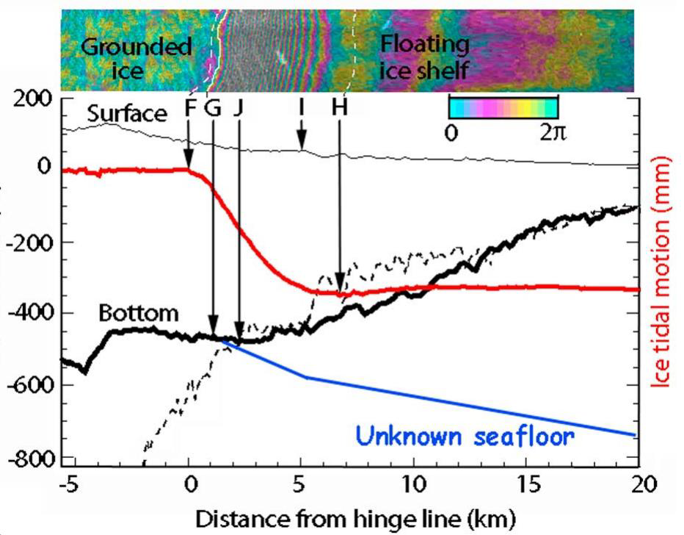
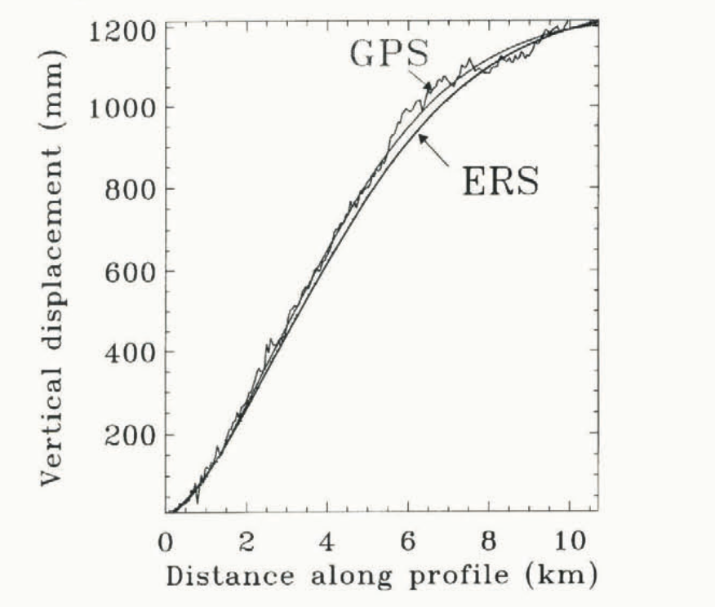
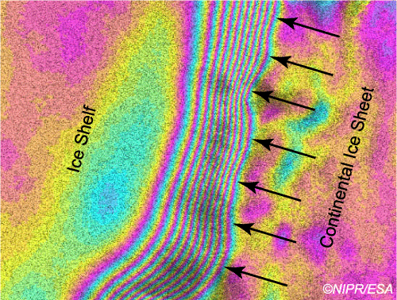
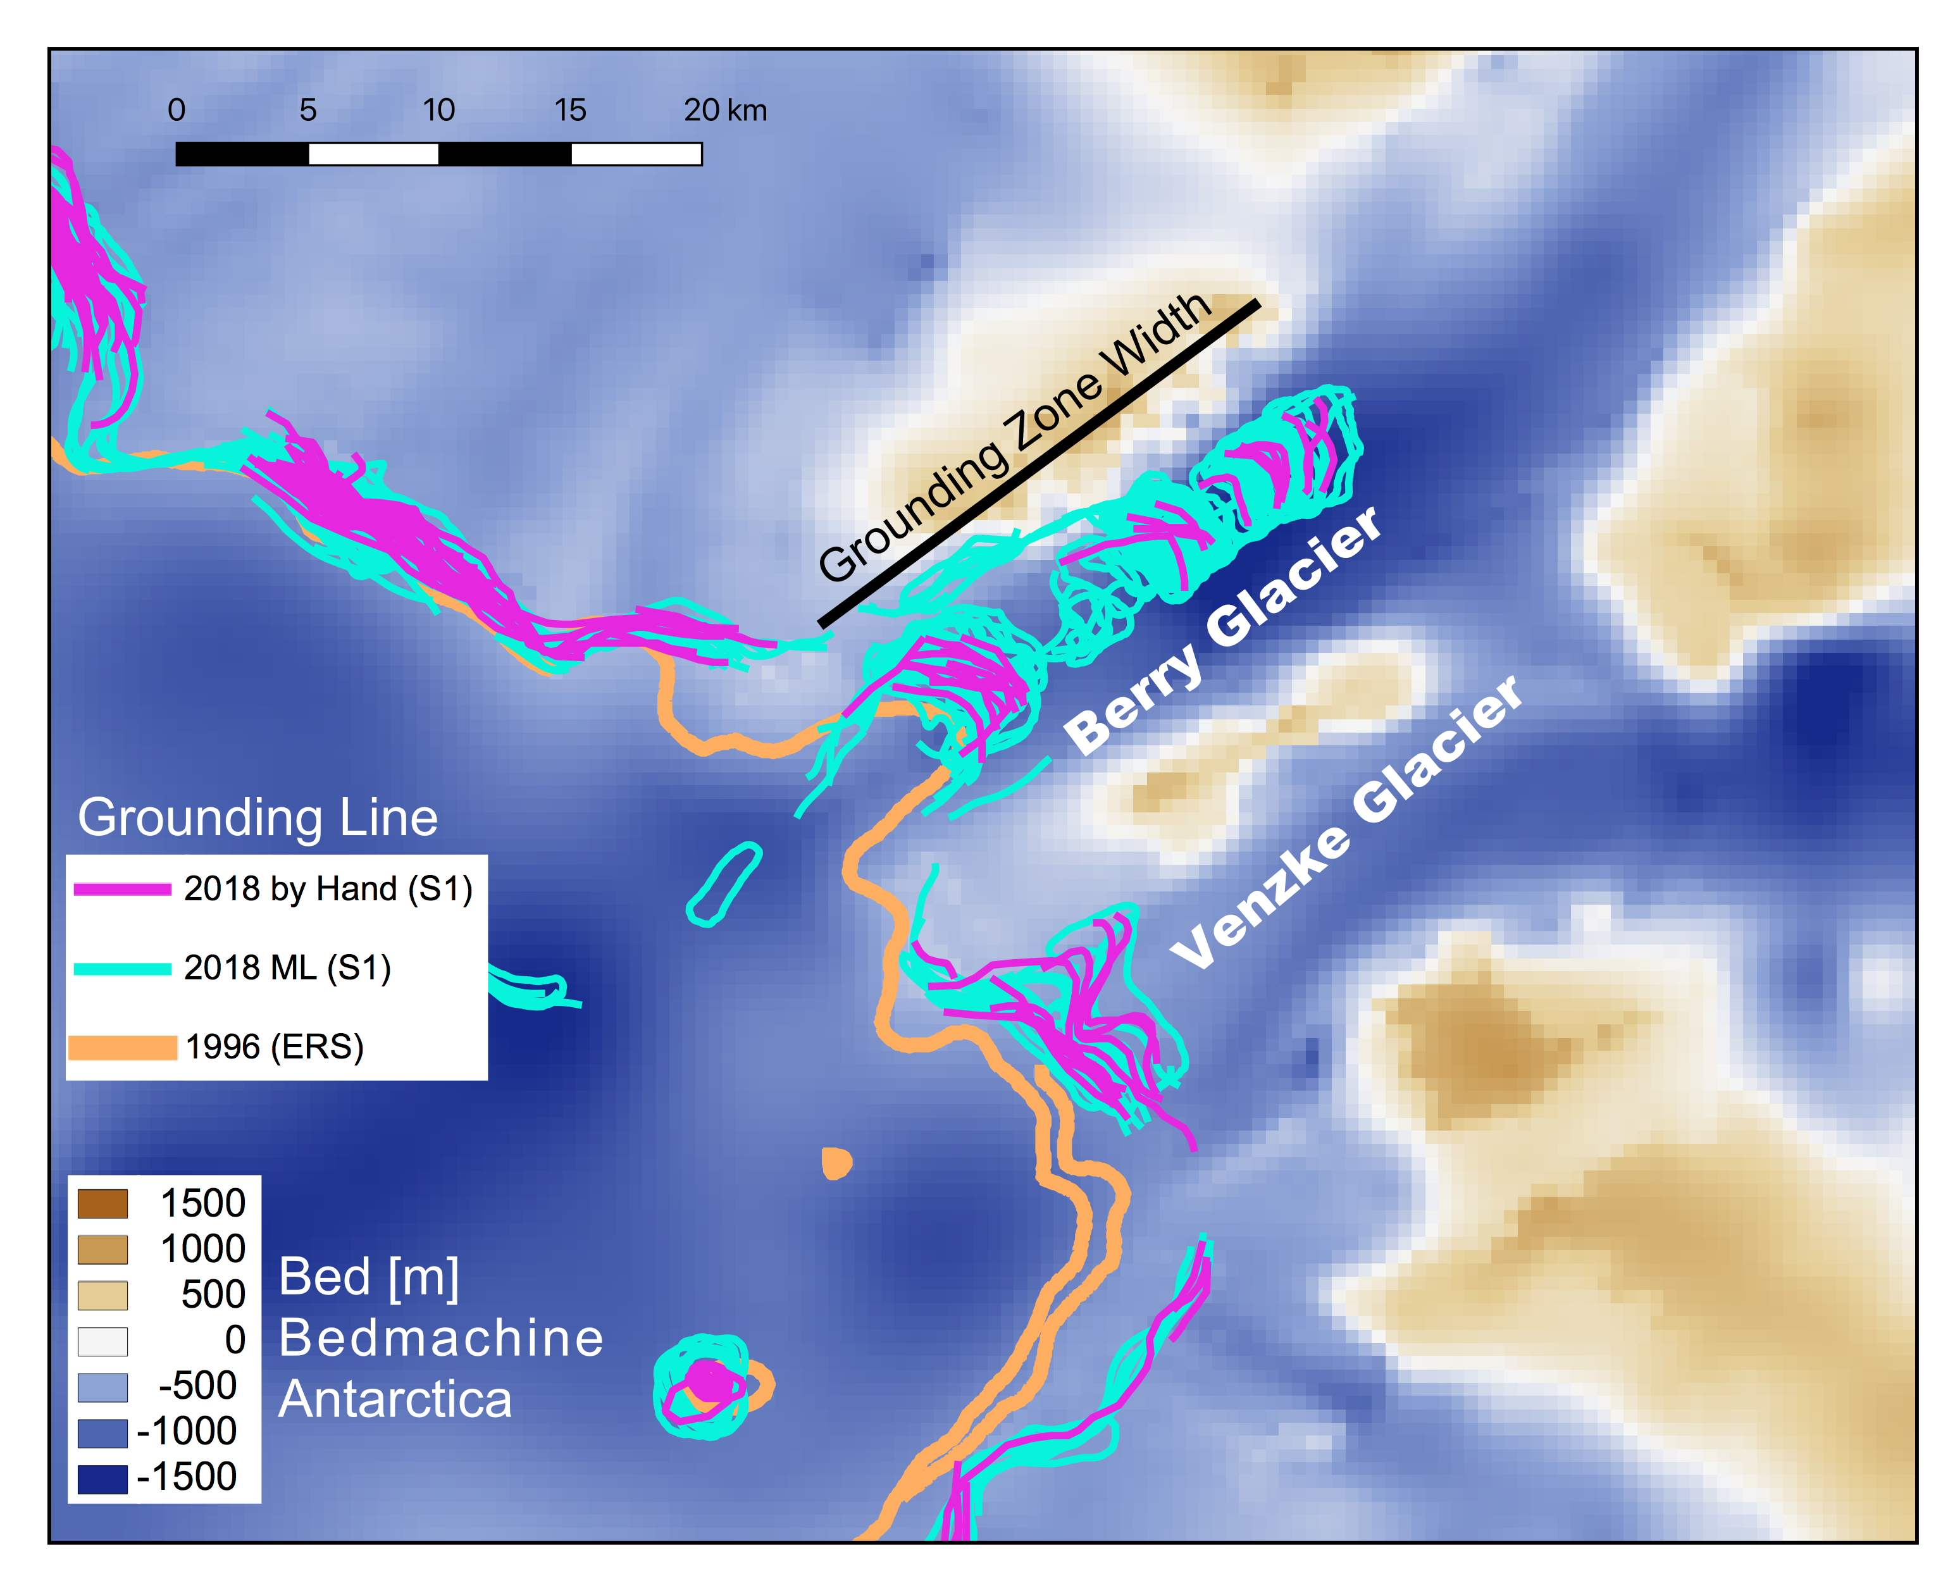
Tidal motion and grounding line detection
For pair 1-2 interferogram: ${\tilde{δ}}_{ρ12}=∆g\sin\left(ψ12\right)−∆z12cos⁡(ψ12)$
For pair 2-3 interferogram: ${\tilde{δ}}_{ρ23}=∆g\sin\left(ψ23\right)−∆z23cos⁡(ψ23)$
For $ψ12$~ $ψ23$ difference is: $∆z23$ $−∆z12$ $=({\tilde{δ}}_{ρ12}{−\tilde{δ}}_{ρ23}$)/ $cos⁡(ψ)$
Grounding line at inner limit of tidal fringes: $∆z23$ $−∆z12$ ~ 0
Rignot, Ann. Glaciol. 1998

Slide 16
Implementation
Algorithms just described are fairly generic but there are multiple ways to implement.

Slide 17
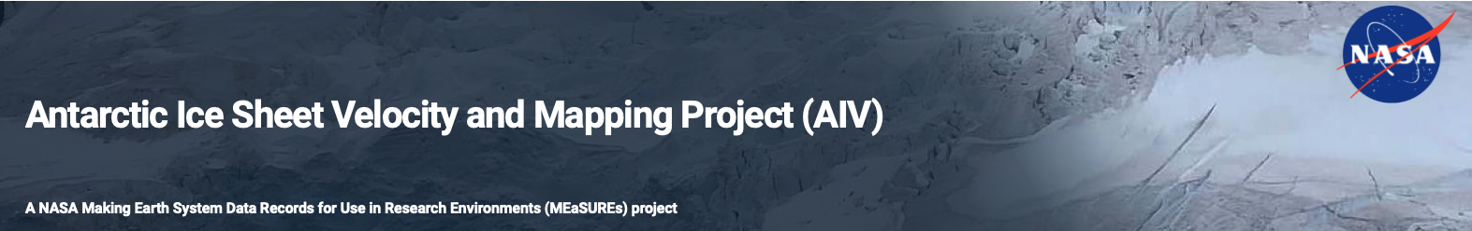
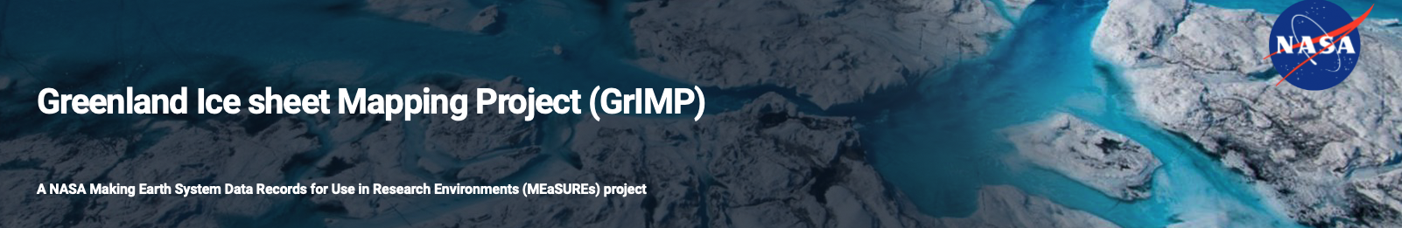
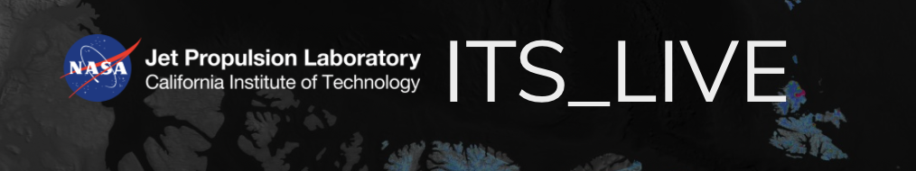
NASA Supported L3/L4 Processors
There are several other systems supported by ESA and other space agencies.

Slide 18
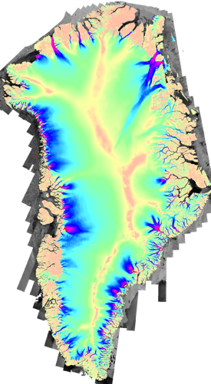
GrIMP Implementation
L1 – SAR SLCs
L2 – Offsets/Interferograms
L3 – Gridded Mosaics
Speckle Tracking
Calibration
LSQFit
Mosaicking
Interferograms
Ionosphere Correction
Calibration
LSQFit
Input is 100s to 1000s of SLCs for continental scale mosaic.
In current processing calibration step LSQ fit for unknown constants (with S1 orbits single constant for each pair).
Mosaicking computes an error-weighted average of all estimates (phase/offsets).
Rosen, Project Scientist
This document contains export-restricted data.

Slide 19
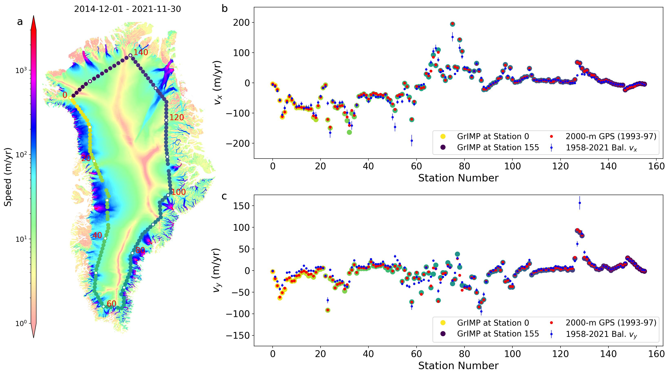


Pseudo Validation
$$μ_{x}=−0.67,σ_{x}=3.36$$
Comparison of annual map with GPS points collected along the nominal 2000-m contour by NASA in the 1990s.
Not a true validation since its unclear what the relative contributions of errors and true change are to the differences.
$$μ_{y}=−0.56,σ_{y}=2.91$$

Slide 20
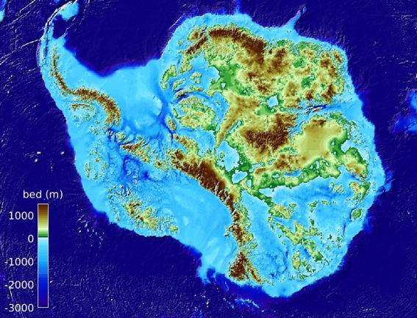

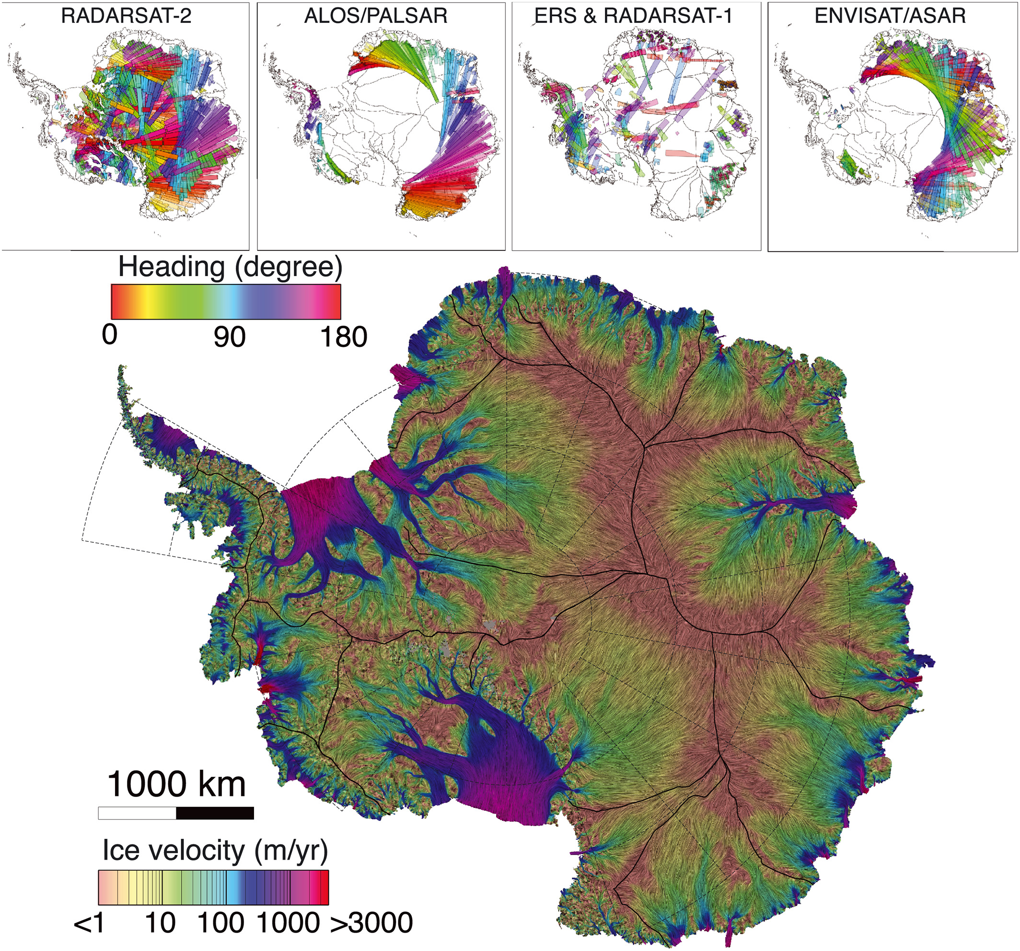
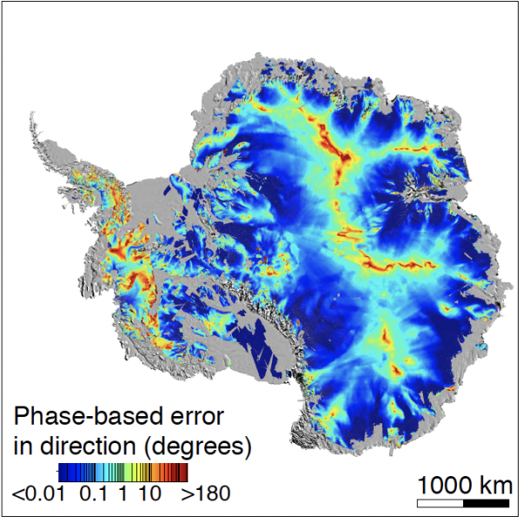


MEaSUREs-3 Antarctica Implementation
L1 – SAR SLCs
L3 – Gridded Mosaics
L2 – Offsets/Interferograms
Speckle Tracking
Calibration
Mosaicking
Speckle tracking
Phase only
Phase only
Ionosphere Correction
Calibration
Mosaicking
L4 product -BedMachine
Input is 1000s of SLCs (S1, RADARSAT-2, Envisat ASAR, ALOS PALSAR, CSK-2G) for continental scale mosaic.
Automatic calibration with slow moving areas from reference velocity map.
Both speckle tracking (annual to monthly) and phase only (multi-annual) include error estimates.
Phase map assumes surface parallel flow. Prototype 3D phase map uses multiple tracks.
Rosen, Project Scientist
This document contains export-restricted data.

Slide 21
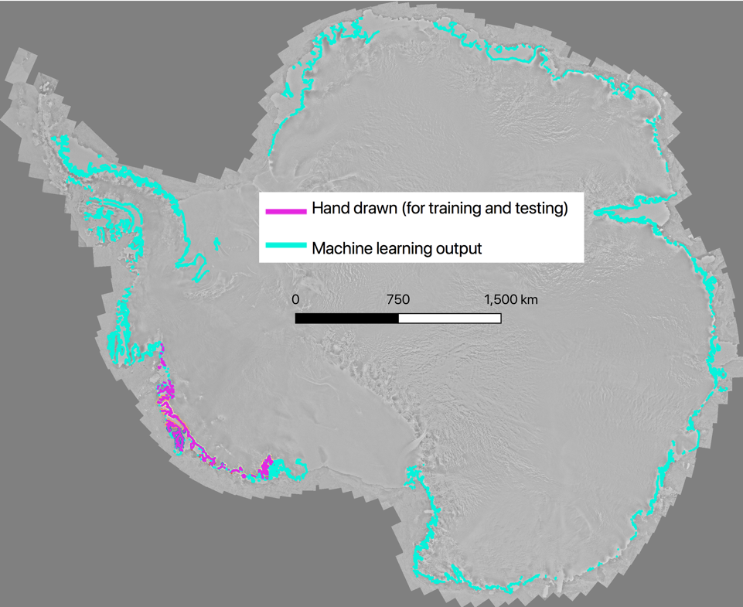

MEaSUREs-3 Antarctica Implementation
L1 – SAR SLCs
L2 – Offsets/Interferograms
Interferograms
Differential
Deep learning
Input is 1000s of SLCs (S1, CSK-2G) for continental scale mosaic.
Machine learning algorithm to pick grounding lines.
Time series of grounding lines used to define grounding zones (yearly to monthly).
Rosen, Project Scientist
This document contains export-restricted data.

Slide 22
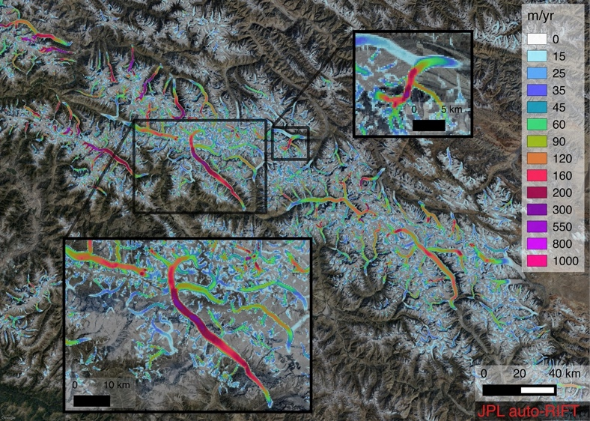
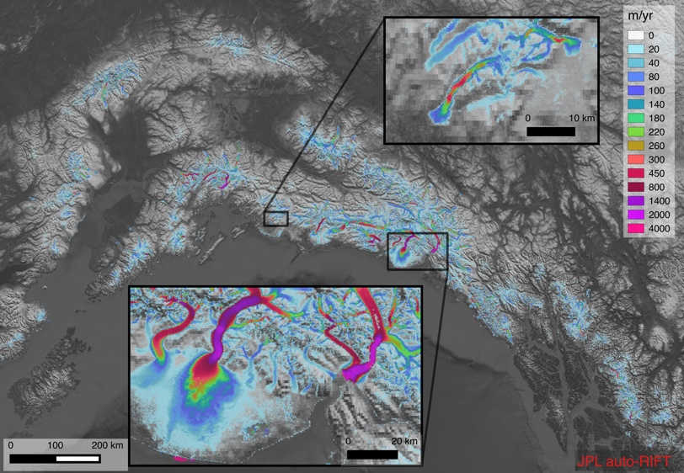
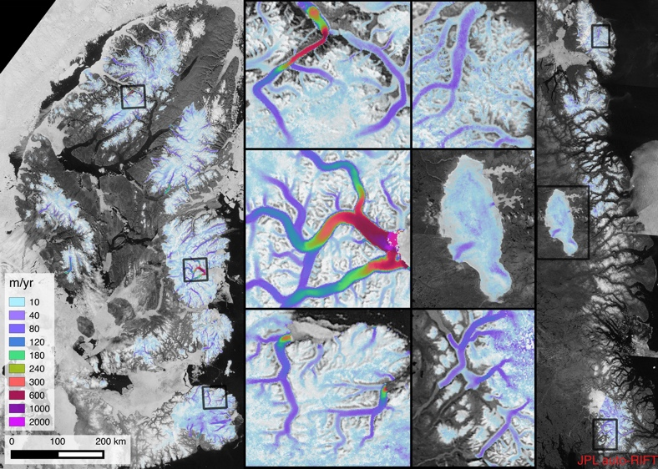
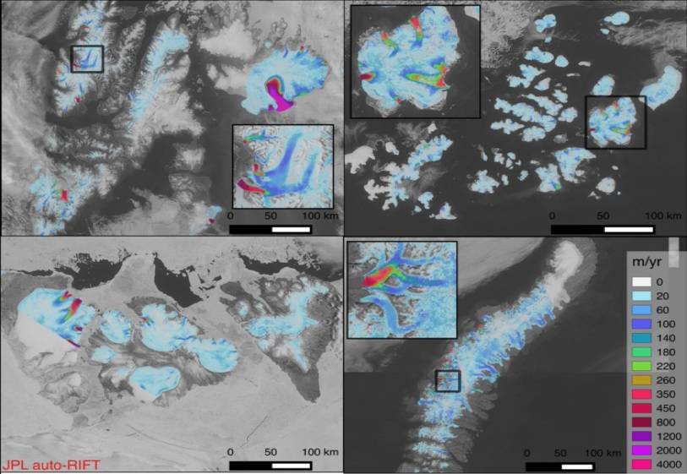
ITS_LIVE MeASUREs
High Mountain Asia
Alaska
Canadian Arctic
Russia and Svalbard

Slide 23
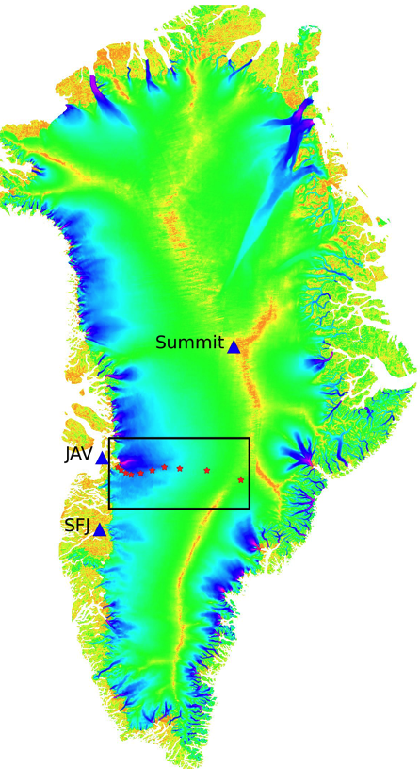
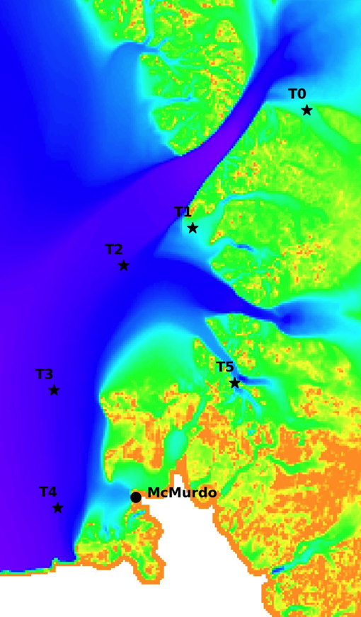
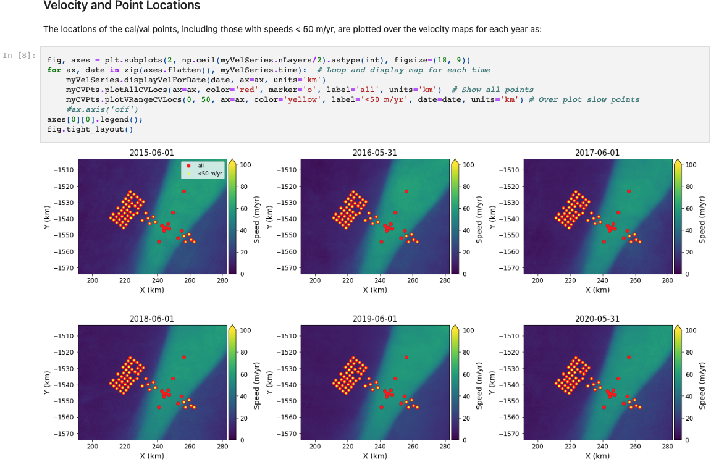
Cryosphere Cal/Val
The project will support 16 GNSS ice sheet stations (other contributions welcome).
Cal/Val Approach:
Science Team generates L3 products.
Products are validated against GNSS and other data in Jupyter notebooks.

Slide 24
Overall Cal/Val Process
GNSS Sites
Iridium
UNAVCO
Validation Report for given period and requirement
GNSS data
L3 products & cal/val data
Jupyter Notebooks
NISAR Cal/Val Database
L3 products
L0/L2 Processor
ST L3 Algorithms

Slide 25
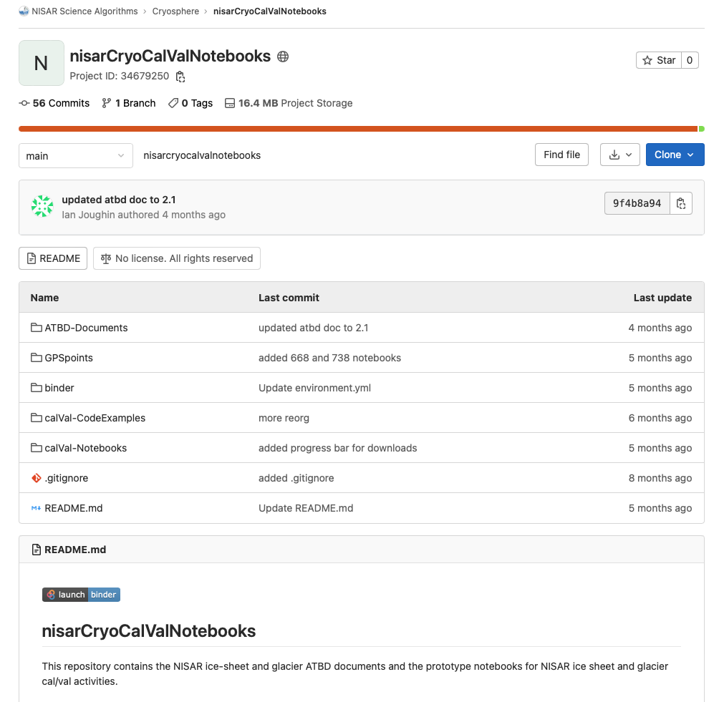
ATBD documents, Notebooks, and supporting code are all available through project gitlab site: https://gitlab.com/nisar-science-algorithms/cryosphere/nisarcryocalvalnotebooks
Which mirrors: https://github.com/fastice/nisarCryoCalValNotebooks
The notebooks can all be demonstrated using “launch binder” button.
Proof of concept is with GrIMP products at NSIDC but will be modified to pull full range of products on NISAR cal/val server.

Slide 26
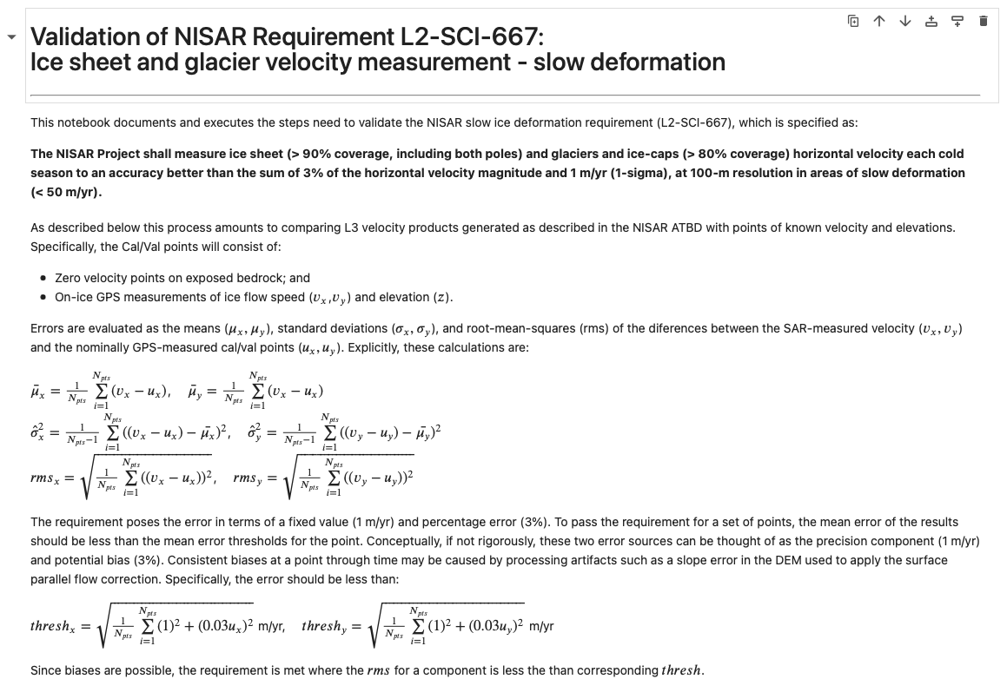
Validation Notebooks - Introduction

Slide 27
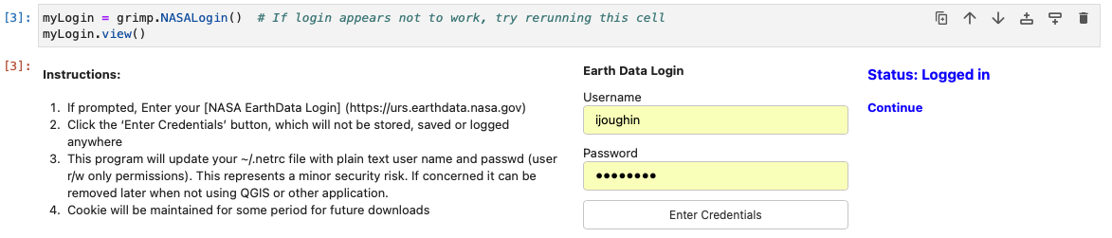
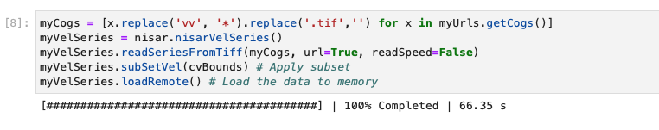
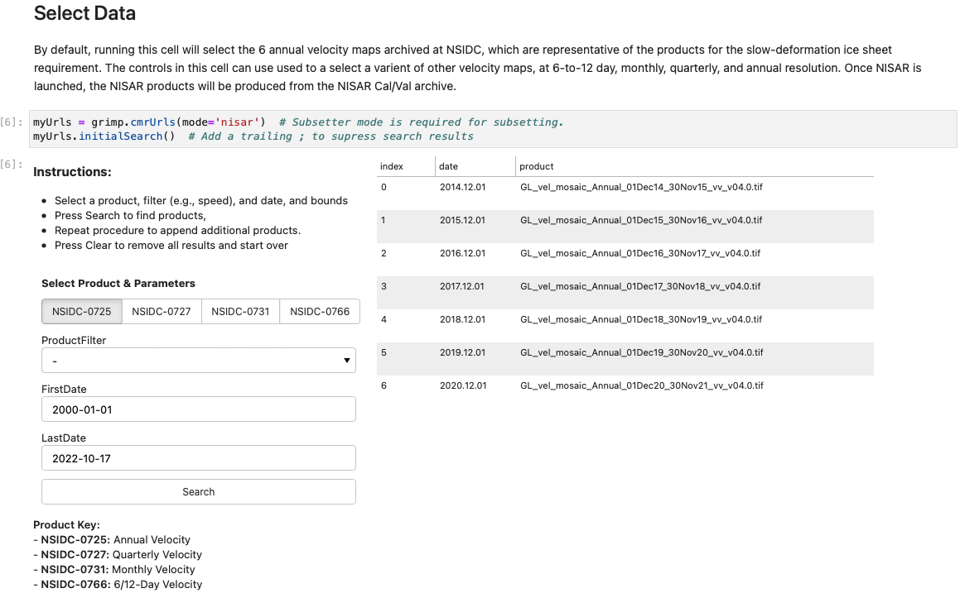
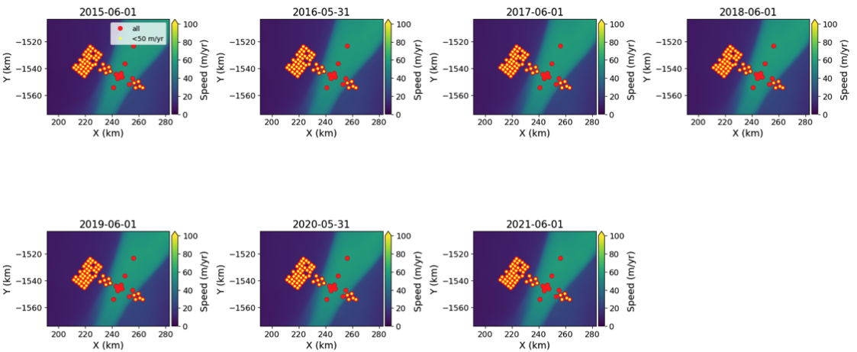
Validation Notebooks - Overview

Slide 28
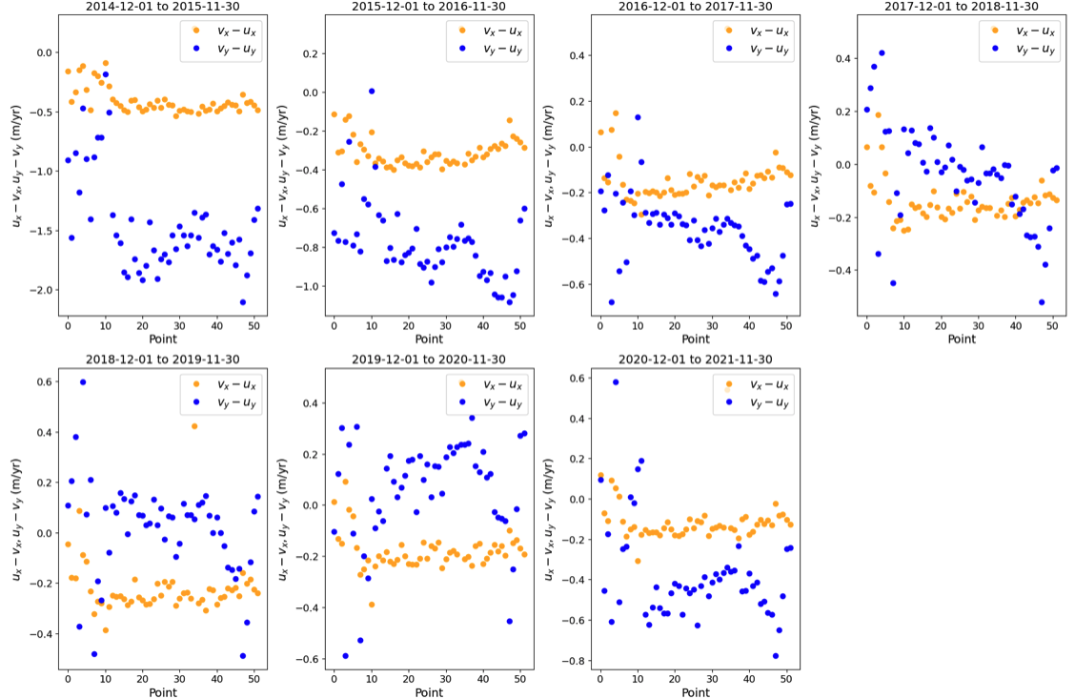
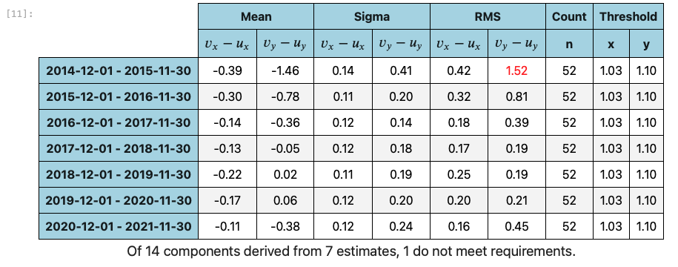
Validation Notebooks - Results

Slide 29
Cryosphere ATBD
Questions?

